Slide 1
Working with DOM
Manipulating DOM elements

Slide 2
Adding and Deleting Elements
Method | Description
document.createElement(element) | Create an HTML element
document.removeChild(element) | Remove an HTML element
document.appendChild(element) | Add an HTML element
document.replaceChild(element) | Replace an HTML element
document.write(text) | Write into the HTML output stream

Slide 3
What is first? create
Document Object Model (DOM)
1st Create a element node
Once created:
Add (appendChild)
Remove (removeChild)
Move or reposition (insertBefore or insertAfter)
var para = document.createElement("p");
var node = document.createTextNode("This is new.");

Slide 4
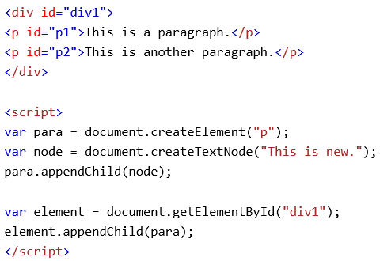
What is next? append
Create element(element node) first

Slide 5
What is next? Access
Use getElementById to find the parent
Use getElementById to find the child
var element = document.getElementById("div1");
var child = document.getElementById("p1");
Then you can have fun

Slide 6
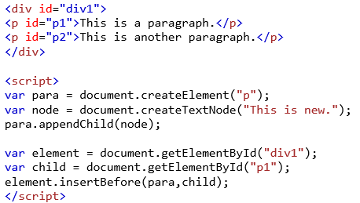
What is next? Now you can reposition
Create element(element node) first

Slide 7
What is it good for?
Examples:
Adding text content
Removing images
Moving tables or content around

Slide 8
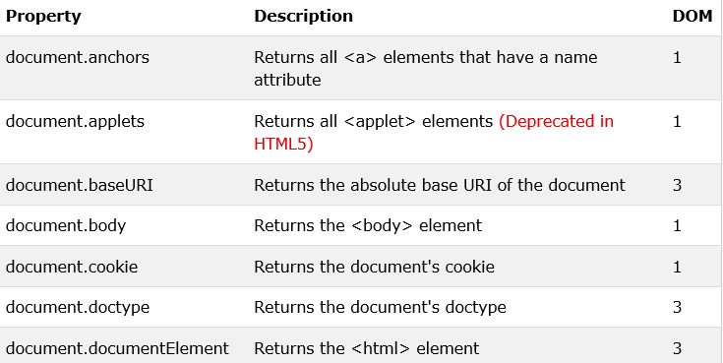
Other options?

